Slide 1
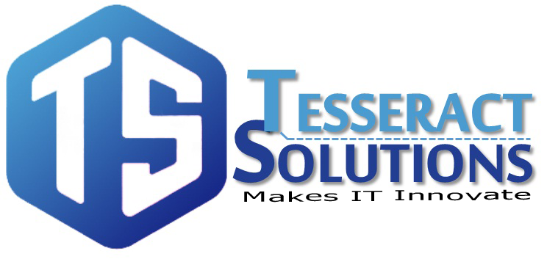
https://www.facebook.com/tesseractspl
https://www.linkedin.com/company-beta/11222535/

Slide 2
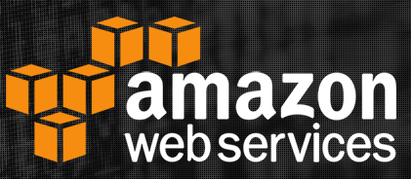
Virtual Private Cloud

Slide 3

AGENDA
Introduction
VPC Component
VPC & Subnets
Security Groups
Network ACLs
Route Tables
VPN Connection
AWS Direct Connect
AWS Internet Gateway
VPC Peering
Limits of VPC

Slide 4
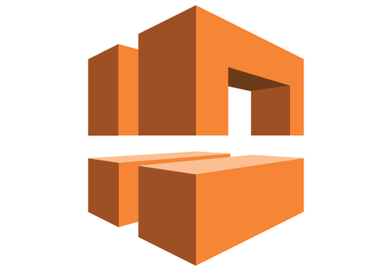
Introduction
Amazon Virtual Private Cloud (Amazon VPC) enables you to launch AWS resources into a virtual network that you've defined. A virtual private cloud (VPC) is a virtual network that closely resembles a traditional network that you'd operate in your own data center, with the benefits of using the scalable infrastructure of Amazon Web Services (AWS)

Slide 5

VPC Components
VPC – Virtual Private Cloud
Subnet – A range of IP Addresses in your VPC
Network ACLs – Network Access control lists that
are applied to subnets
Route Table – Applied to subnet specifying
route policies.
VPN Connection – A pair of redundant encrypted
connection between your datacenter and your Amazon VPC
AWS Direct Connect – Private connection between your data
center and your VPC

Slide 6
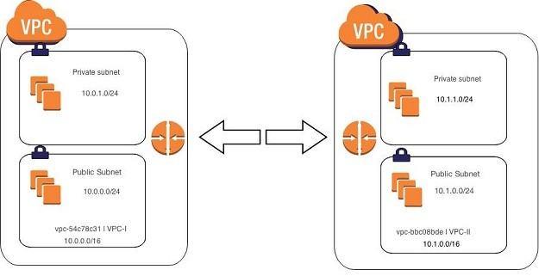
VPCs & Subnet
A subnet is a range of IP addresses in your VPC. You can launch AWS resources into a specified subnet. Use a public subnet for resources that must be connected to the internet, and a private subnet for resources that won't be connected to the internet

Slide 7
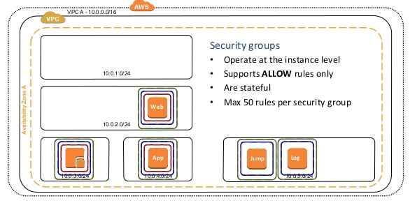
Security Groups
A security group acts as a virtual firewall for your instance to control inbound and outbound traffic. For each security group, you add rules that control the inbound traffic to instances, and a separate set of rules that control the outbound traffic.

Slide 8
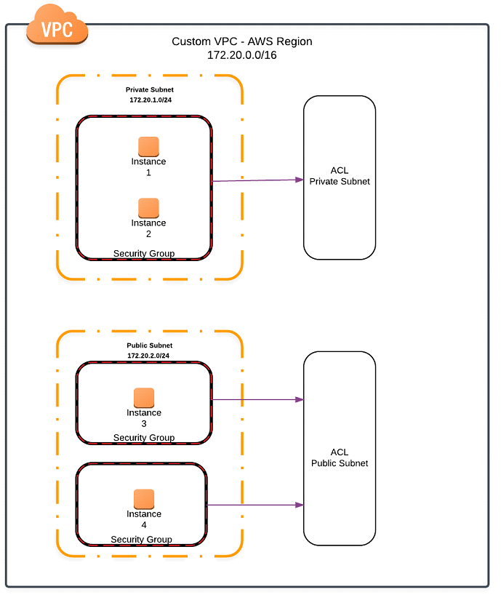
Network ACLs
A network access control list (ACL) is an optional layer of security for your VPC that acts as a firewall for controlling traffic in and out of one or more subnets

Slide 9
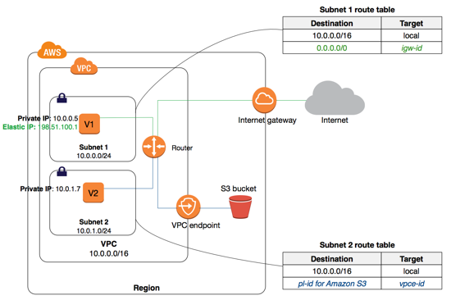
Route Tables
A route table contains a set of rules, called routes, that are used to determine where network traffic is directed.

Slide 10
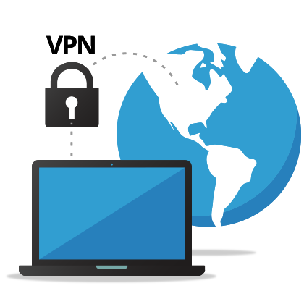
VPN Connections
You can connect your VPC to remote networks by using a VPN connection. The following are some of the connectivity options available to you.
AWS managed VPN
AWS VPN CloudHub
Third party software VPN appliance

Slide 11
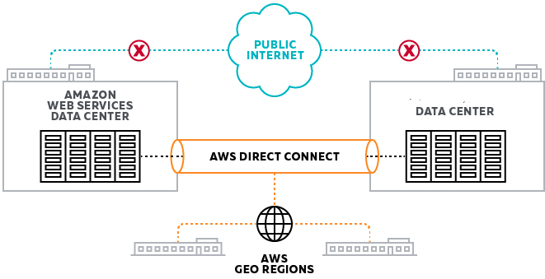
AWS Direct Connect
AWS Direct Connect links your internal network to an AWS Direct Connect location over a standard 1-gigabit or 10-gigabit Ethernet fiber-optic cable.

Slide 12
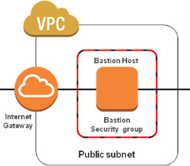
AWS Internet Gateway
An Internet gateway is a horizontally scaled, redundant, and highly available VPC component that allows communication between instances in your VPC and the Internet.

Slide 13
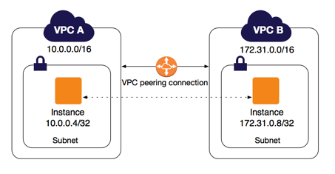
VPC Peering
A VPC peering connection is a networking connection between two VPCs that enables you to route traffic between them using private IPv4 addresses or IPv6 addresses.

Slide 14

Limits of VPC
5 VPC per region
200 subnets per VPC
200 route tables
500 security groups
50 inbound/outbound rules

Slide 15
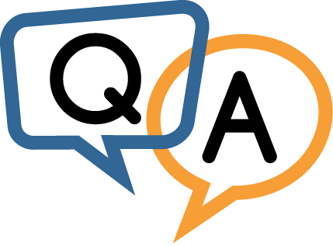

Slide 16


